Slide 1
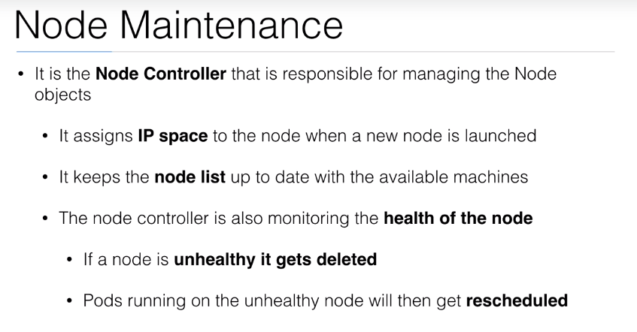


Slide 2
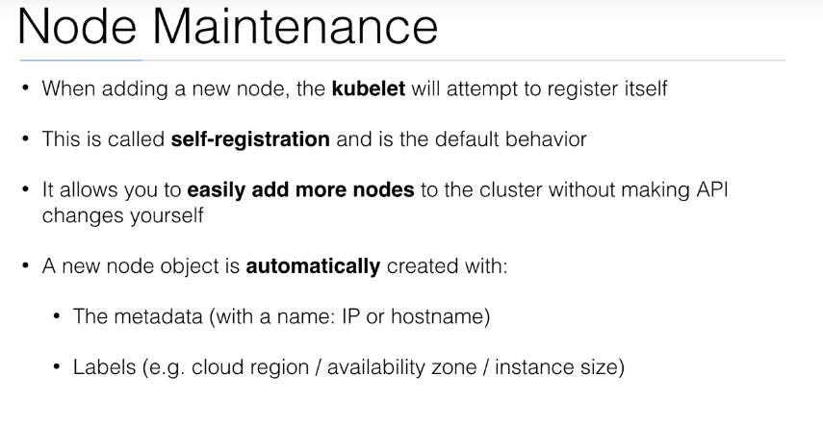

Slide 3
NodeSelector
nodeSelector is the simplest form of constraint. nodeSelector is a field of PodSpec.
It specifies a map of key-value pairs.
For the pod to be eligible to run on a node, the node must have each of the indicated key-value pairs as labels (it can have additional labels as well).
Give some customize label for classify host and define some selector criteria for specific node run Pods

Slide 4
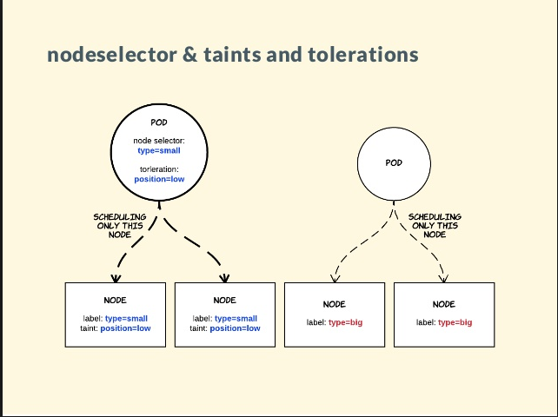
NodeSelector

Slide 5
Taint and Tolerations
Node side consideration • Force/Repel Pods from Node
Taint will apply to Node for protect “node” to run any pods without “tolerate” match taint
Tolerations apply to Pods for suggest (Not required) Pods to schedule
Use Case: o Dedicated Node / Maintenance Node o Special Hardware Node

Slide 6
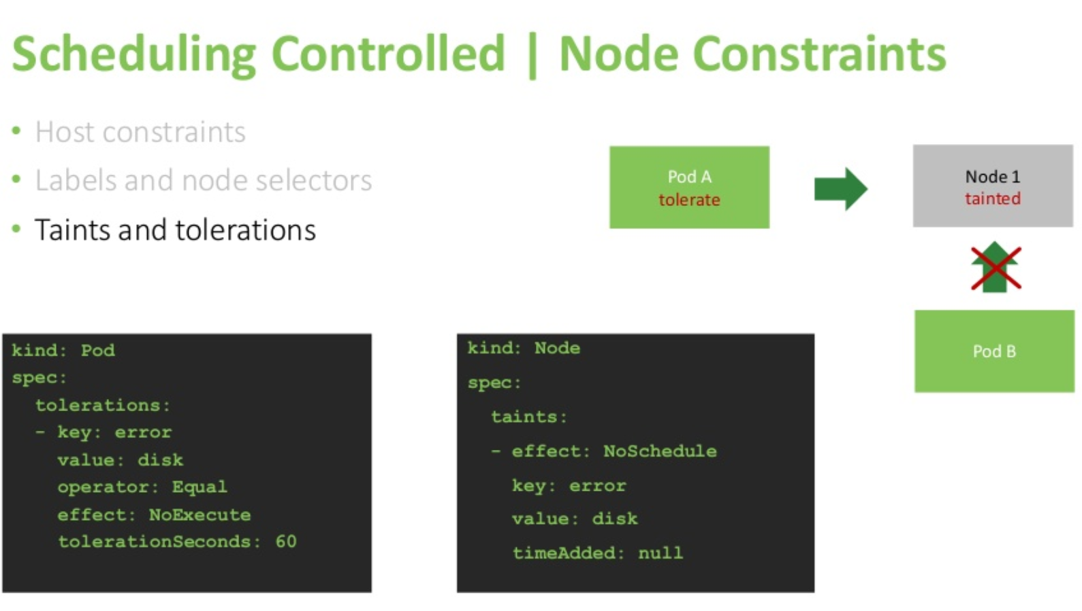

Slide 7
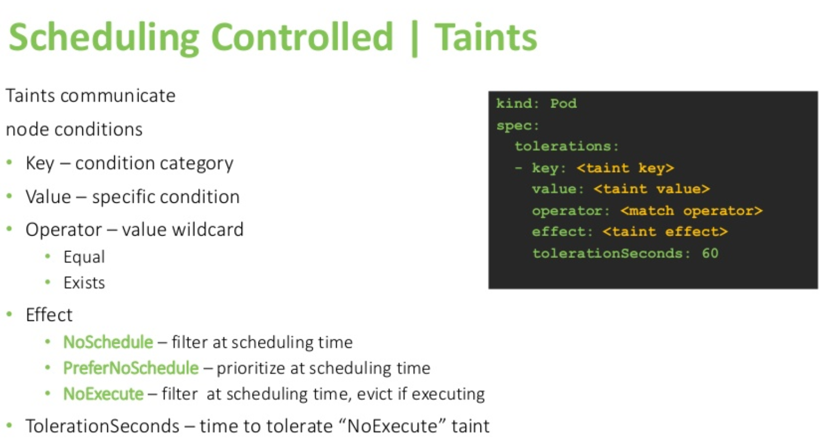

Slide 8
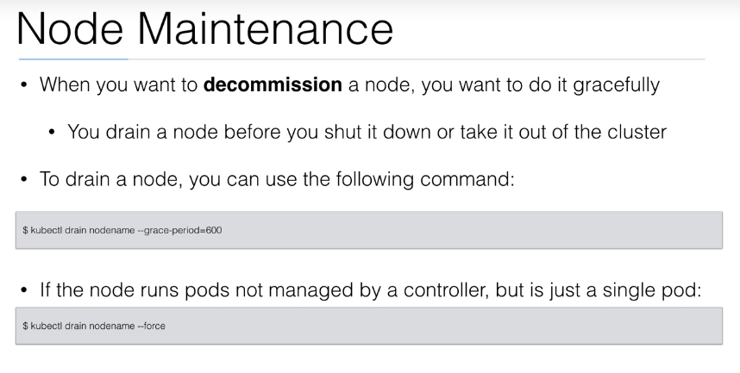

Slide 9
Demo Placeholder
Drain the node

Slide 10


